Slide 1


Repository tool For Blue And Co
Pasindu | A2 ltd

Slide 2



Who we are…
“Software Development is our Passion, Serving you is our freedom..”– A2
We are a ISO (9000,9001) Certified Software Development company which provides IT solutions to our clients needs.
We do have 20 years of experience in software development industry
Main development platform is .NET
Professional and expertise staff
200 and more projects in our portfolio
24/7 Support Service

Slide 3
Key areas to be covered
Description
Current situation
Functionality of a Repository tool
Benefits of using a repository tool
Development method
Quality Assurance
Schedule

Slide 4
Project Description
This project will focus on delivering a repository tool for Blue and Co Company for their Requirement gathering and management process from the stakeholders and solution development period.
The tool will be able to capture the requirements, validate, review and approve. Each business analyst will be handling 6 or more projects at given time frame. It will be using a web based interface to interact with the software and MS SQL as the database.This tool has to work simultaneously.

Slide 5


Current Situation
Currently the process is done by manually
Communication problems via email, fax, phone calls or meetings
Overloaded work for Business Analysts.
Maintaining Large number of Documents for One Project
Consumes more time to Project to be finalized

Slide 6
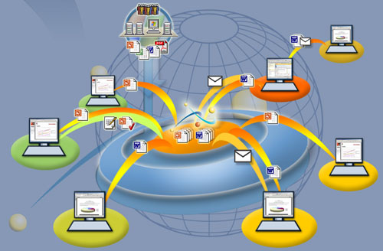
Functionalities of a Repository tool
Version Control
Workflow Management
Web Interface
Notifications
Track Changes
Document delivery
Security
Authentication

Slide 7
Benefits of using a Repository tool
Time
Money
Paper cost
SAVE
Projects
Clients
Profits
MORE

Slide 8
Cost Vs Benefits

Slide 9
Benefits with Numbers
Discount rate | 11%
Assume the project is completed in Year 0 |  |  | Year
 | 0 | 1 | 2 | 3
Costs | 47,834 | 27,027 | 25,160 | 23,398
Discount factor | 1.00 | 0.90 | 0.81 | 0.73
Discounted costs | 47,834 | 27,027 | 25,160 | 23,398
Benefits | 0 | 120000 | 120000 | 120000
Total
$123,419
$293,247
$$169,827
Discounted benefits | 1 | 108,108 | 97,395 | 87,743
Discounted benefits - costs | (47,833) | 81,081 | 72,234 | 64,345

Slide 10
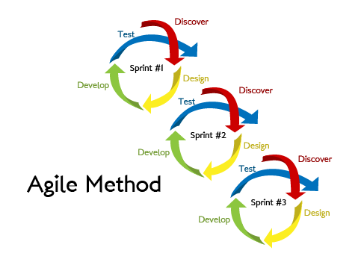
Development Method
The methodology selected for this project is SCRUM. The project will be divided in to
sprint1, sprint2, sprint3 and sprint4.

Slide 11
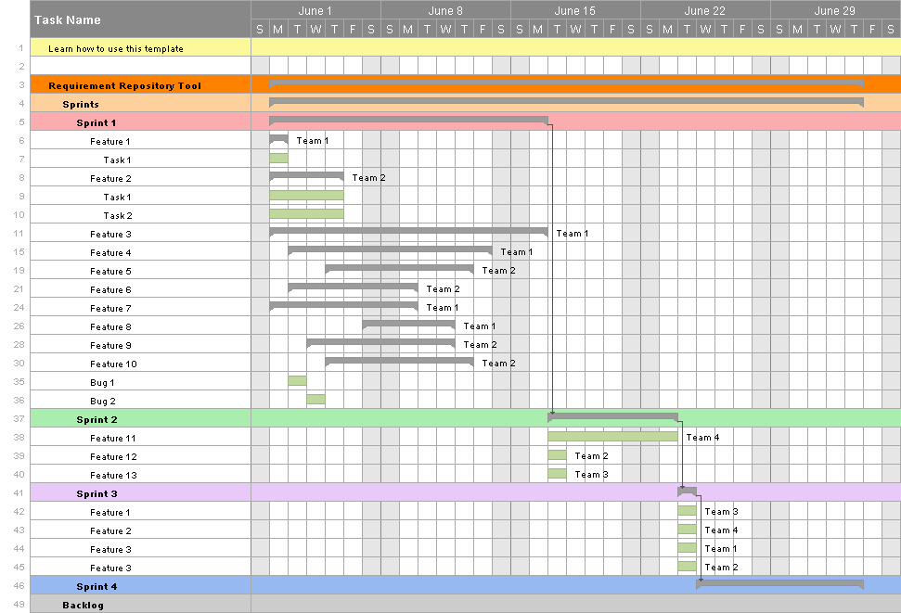
Estimated Time And Structure

Slide 12
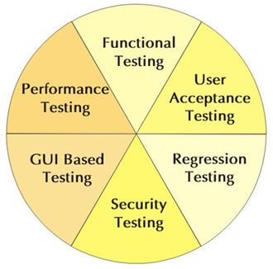
Quality Assurance – “We will never let you down”

Slide 13
Special Package
Free Quality Assurance
24/7 Support service
Free domain name for 1 year
2 months free Maintenance
Special Discount | $49,000 $47,999
*Please note that this package is under certain terms and
conditions

Slide 14
Thank you…

